Slide 1

Identifying a Digital Phenotype of High-Risk COVID-19 Interactions using a Robust University Proximity Network Dataset
Bryn Loftness
Principles of Complex Systems Fall 2021
Project and Data associated to affiliation to Broad Institute of MIT and Harvard

Slide 2

Background
75.7 million ‘interactions’ from August 2020 to May 2021
Each ‘interaction’ is two individuals simultaneously accessing Wi-Fi through the same access point(s) at the same time for 15+ minutes
Extensive metadata collected to relate back to proximity network (test dates, symptom onset dates, sport team involvement, club membership, genomic sequencing data, building wastewater data)

Slide 3
Aims of Analysis
Confirm Expected On-Campus Dynamics to Validate Use of Proximity Network
Confirm Potential Validity in Usage of the Proximity Network as an Asset for Contact Tracing Efforts
Isolate and Model with Derived Features of Risky Interactions to Create New Proximity Network-based Contact Tracing Tool

Slide 4
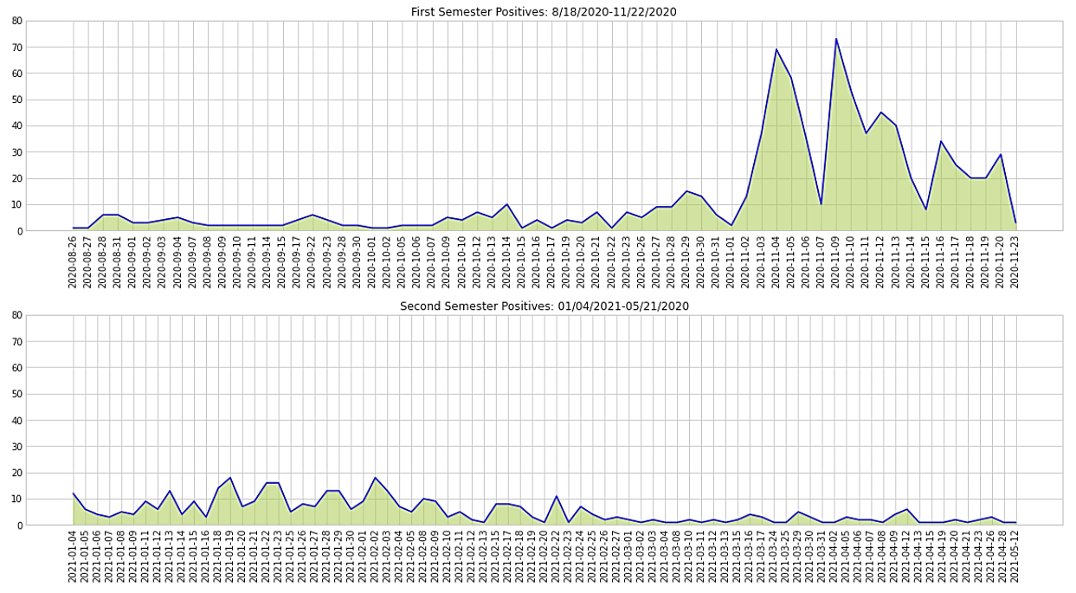
Case Counts at CMU: Fall 2020-Spring 2021
CMU had ~1300 positive cases over the 9 months, including students, faculty, and staff
10,835 students; first and second year students must live on campus

Slide 5
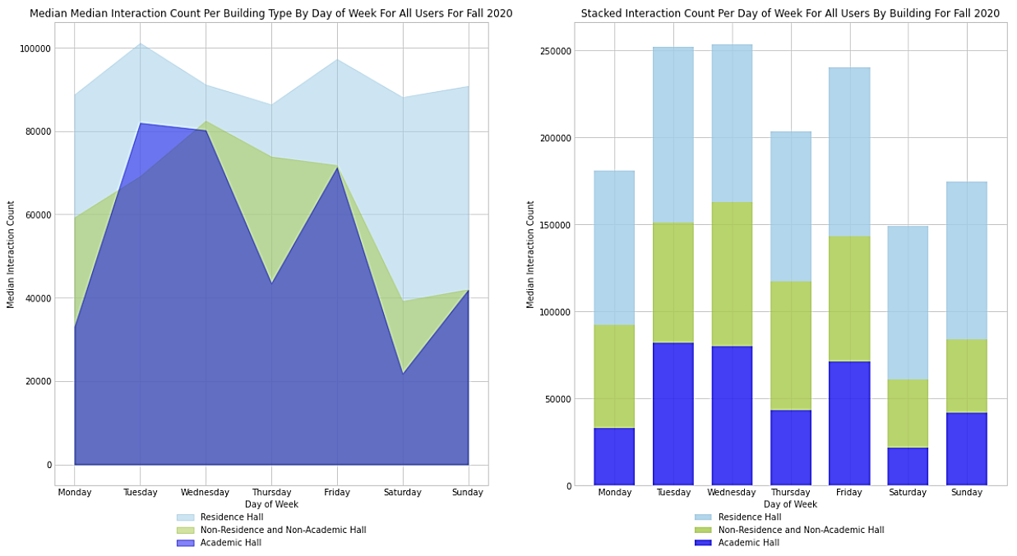
Aim 1

Slide 6
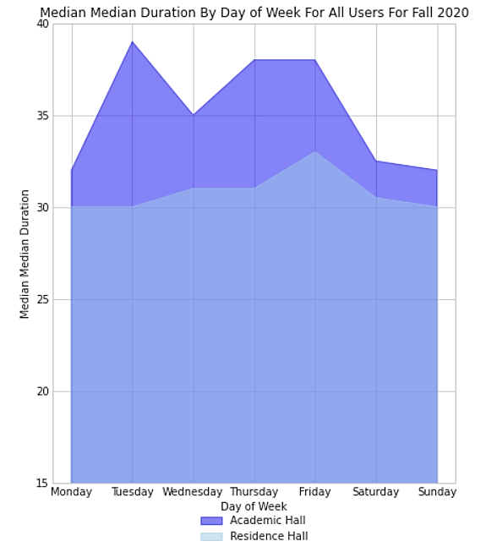
Aim 1

Slide 7
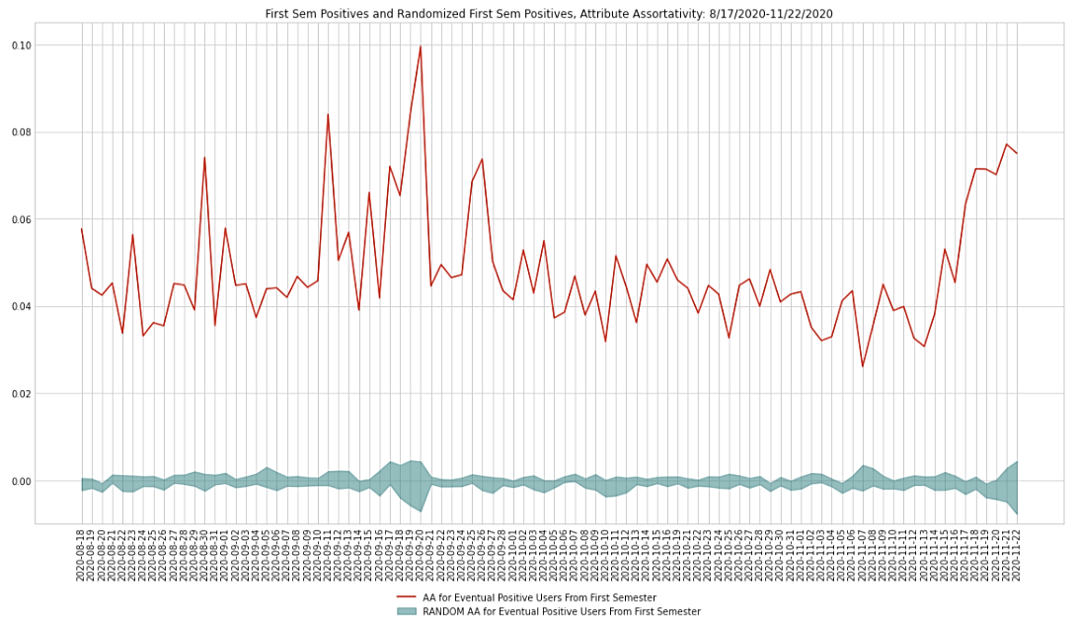
Aim 2

Slide 8
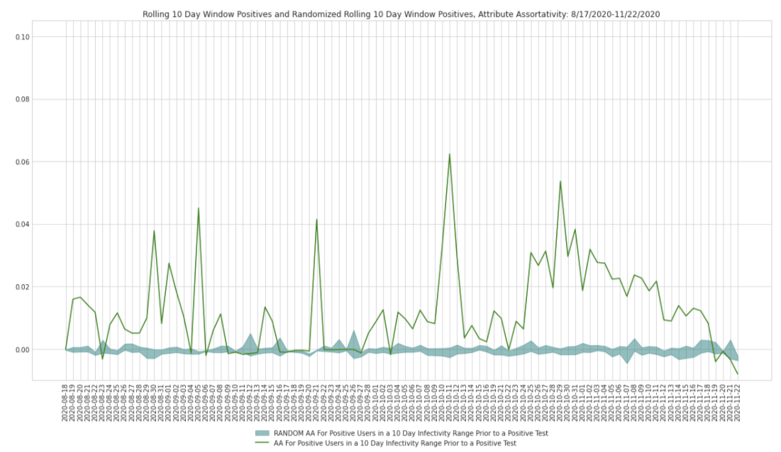
Aim 2

Slide 9
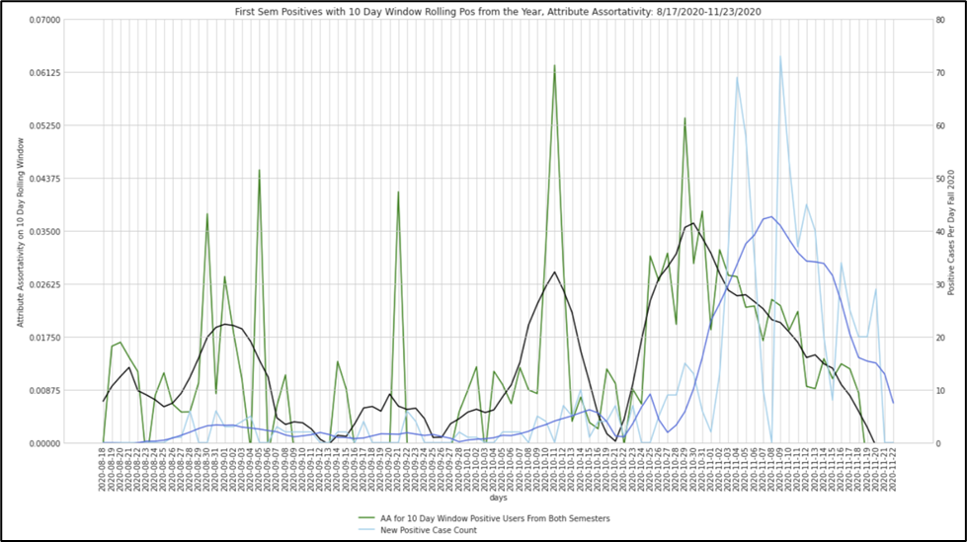
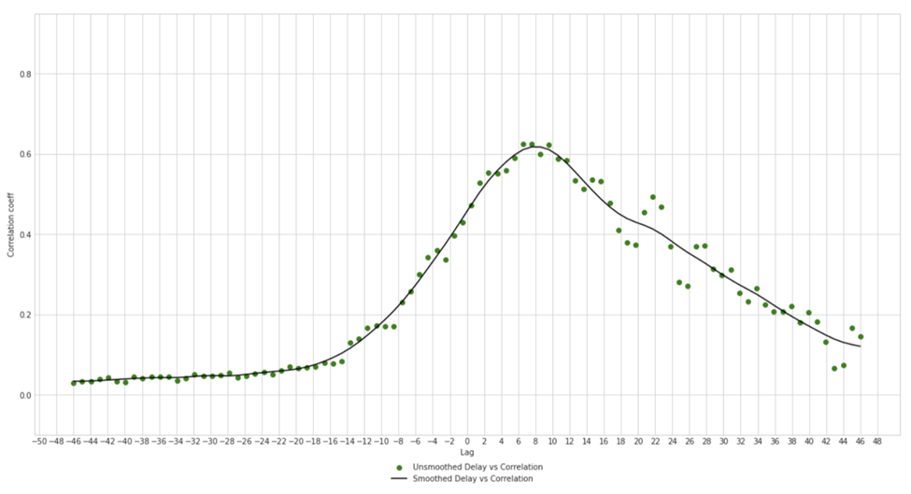
Aim 2

Slide 10
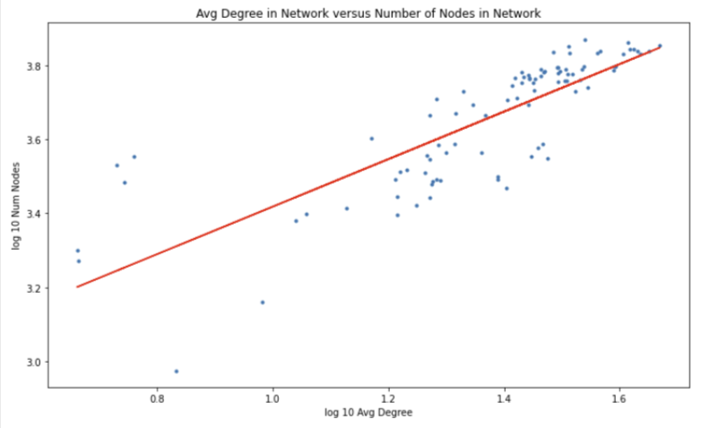
Other Stuff
Slope = .6412, intercept = 2.777,p value = 8.844e-23, std error = .0485

Slide 11
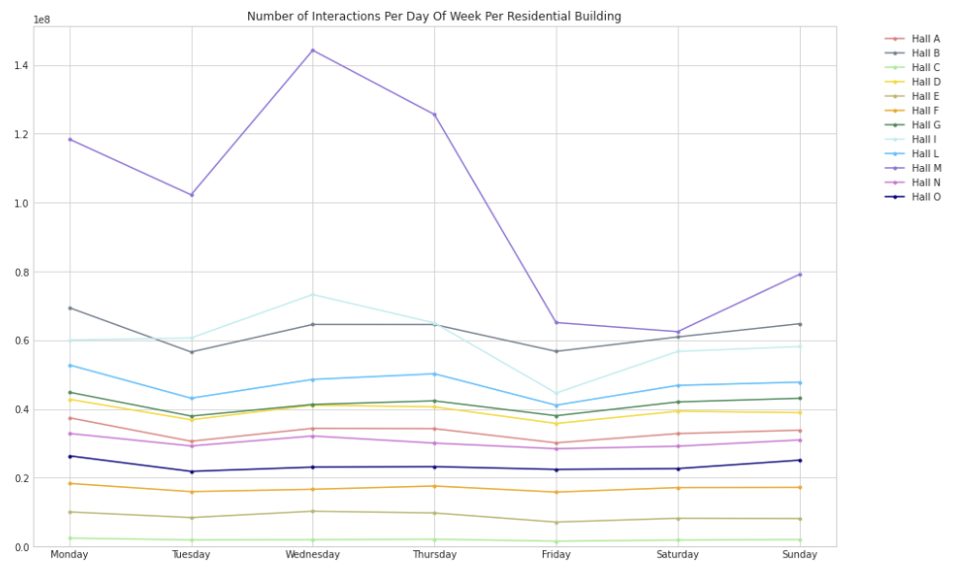
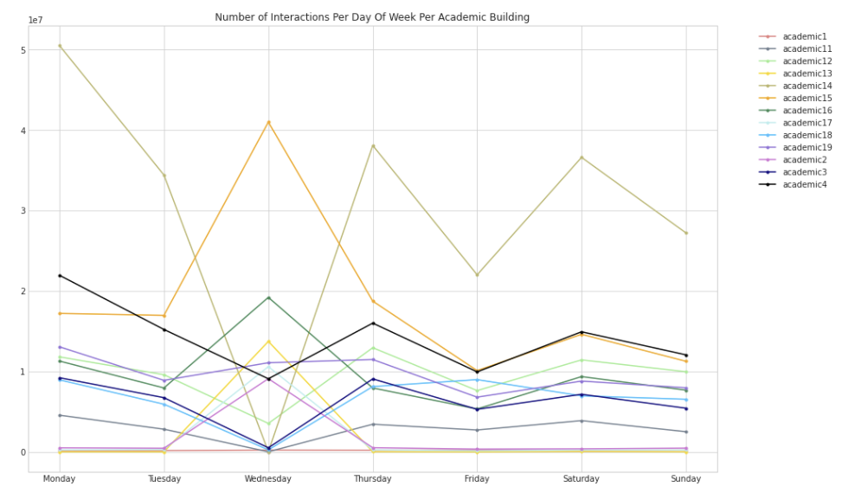
Other Stuff

Slide 12
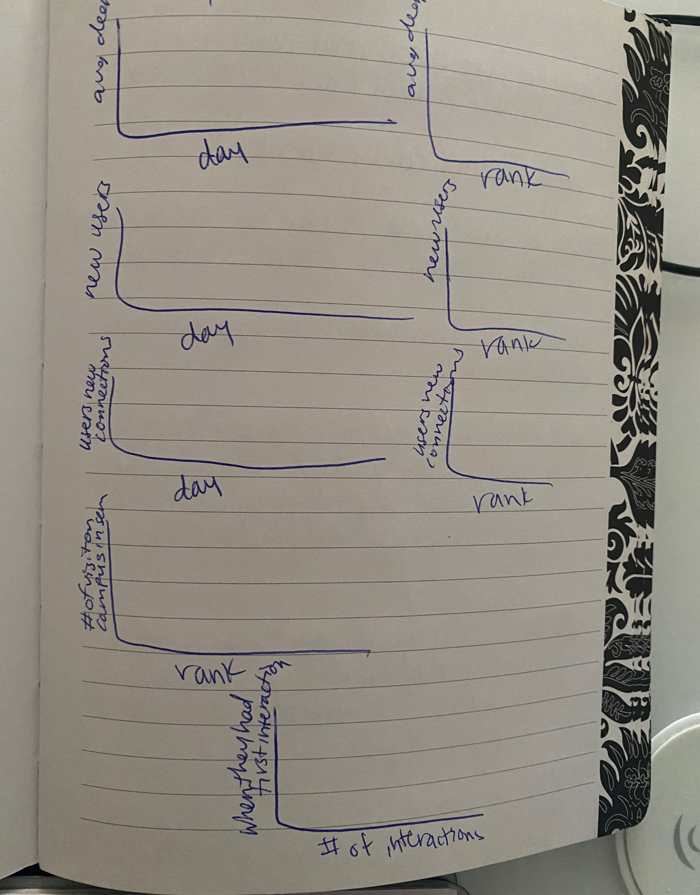
Other Stuff I haven’t done yet

Slide 13
Next Steps
Deeper analysis of the interactions leading up to an individual's positive test could yield potential and probable close-contact detection models through this proximity network (Aim 3)
Thanks for listening!

